Slide 1
Chapter V
Vertex Processing
All class materials including this PowerPoint file are available at
https://github.com/medialab-ku/openGLESbook

Slide 2
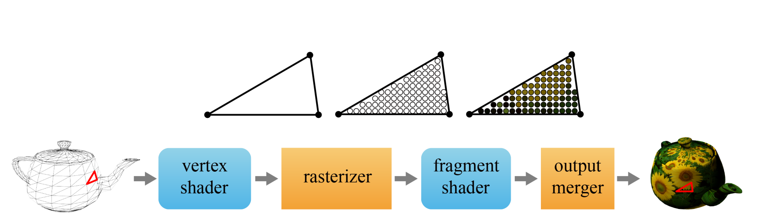
GPU Rendering Pipeline
In the GPU, rendering is done in a pipeline architecture.
A shader is a synonym of a program. We have to provide the pipeline with two programs, i.e., the vertex and fragment shaders. In contrast, the rasterizer and output merger are hard-wired stages that perform fixed functions.
  The vertex shader performs various operations on every input vertex stored in the vertex array.
  The rasterizer assembles triangles from the vertices and converts each triangle into fragments. A fragment is defined for a pixel location of the triangle on the screen and refers to a set of data used to determine a color.
  The fragment shader computes the fragment color.
  The output merger uses the fragment color to determine the pixel color.
5-<number>

Slide 3
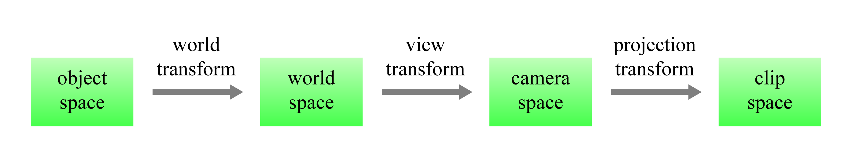
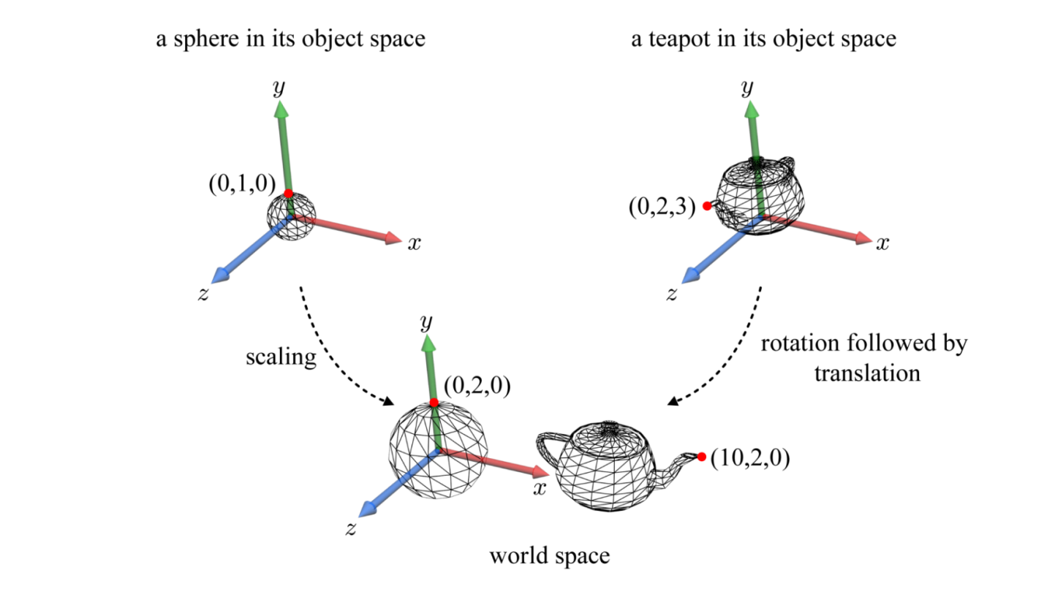
GPU Rendering Pipeline (cont’d)
Among the operations performed by the vertex shader, the most essential is applying a series of transforms to the vertex.
We’ve learned the world transform at Chapter 4.
5-<number>

Slide 4
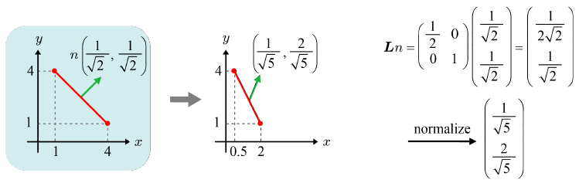
World Transform - Revisited
Previously, the world transform was applied to vertex positions in the vertex array. How about vertex normals?
If the world transform is in [L|t], the normals are affected only by L, not by t.
If L includes a non-uniform scaling, it cannot be applied to surface normals. See the triangle normal example shown below.
The triangle’s normal scaled by L is not any longer orthogonal to the triangle scaled by L.
5-<number>

Slide 5
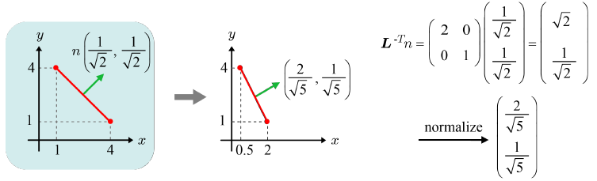
World Transform – Revisited (cont’d)
Instead, we have to use inverse transpose of L, i.e., (L⁻¹)^{T}.
It is simply denoted by L^{-T}.
If L does not contain any non-uniform scaling, n can be transformed by L. However, Ln and L^{-T}n have the same direction even though their magnitudes may be different. Therefore, we can transform n consistently by L^{-T} regardless of whether L contains a non-uniform scaling or not.
Vertex normals are transformed by L^{-T}.
Note that the the vertex normals transformed by L^{-T} will be finally normalized.
5-<number>

Slide 6
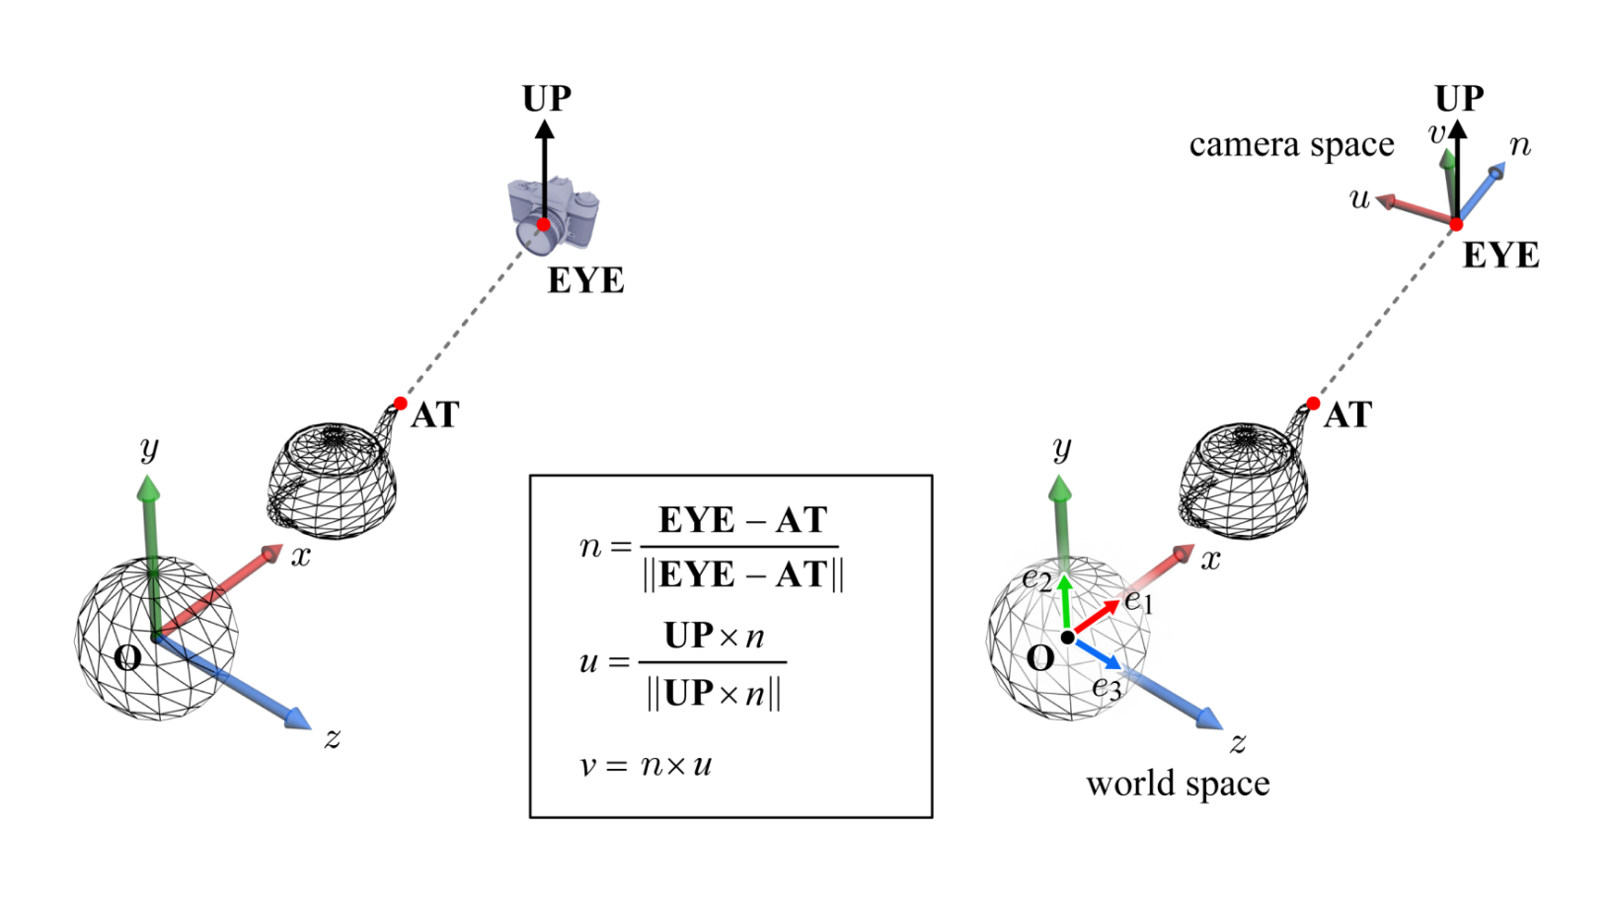
View Transform
Camera pose (position + orientation) specification in the world space
  EYE: camera position
  AT: a reference point toward which the camera is aimed
  UP: view up vector that describes where the top of the camera is pointing. (In most cases, UP is set to the vertical axis, y-axis, of the world space.)
The camera space, {u, v, n, EYE}, can be created. Note that {u, v, n} is an orthonormal basis.
5-<number>

Slide 7
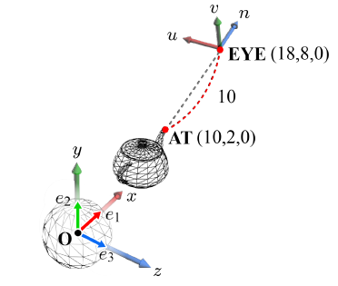
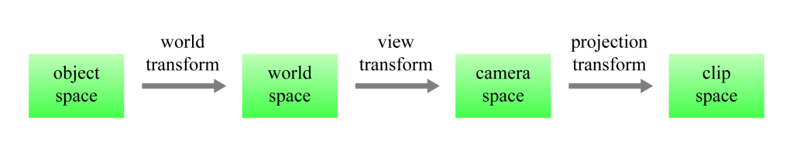
View Transform (cont’d)
A point is given different coordinates in distinct spaces.
If all the world-space objects can be newly defined in terms of the camera space in the manner of the teapot’s mouth end, it becomes much easier to develop the rendering algorithms.
In general, it is called space change. The space change from the world space {e₁, e₂, e₃, O} to the camera space {u, v, n, EYE} is the view transform.
5-<number>

Slide 8
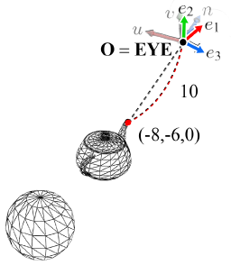
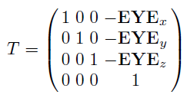
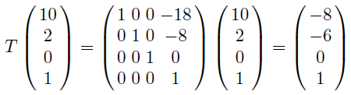
View Transform (cont’d)
The space change can be intuitively described by the process of superimposing the camera space, {u, v, n, EYE}, onto the world space, {e₁, e₂, e₃, O}.
First, EYE is translated to the origin of the world space. Imagine invisible rods connecting the scene objects and the camera space. The translation is applied to the scene objects.
5-<number>

Slide 9
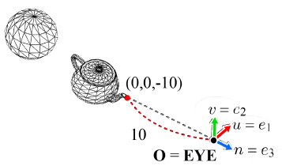
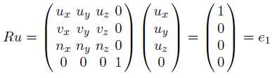
View Transform (cont’d)
Due to translation, the world space and the camera space now share the origin.
We then need a rotation, R, which transforms {u, v, n} into {e₁, e₂, e₃}.
As the world and camera spaces are made identical, the world-space positions of the transformed objects can be taken as the camera-space ones.
The rotation is called basis change, i.e., space change = translation + basis change.
5-<number>

Slide 10
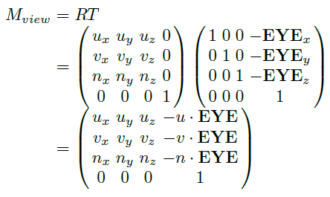
View Transform (cont’d)
The view matrix
  M_{view} is applied to all objects in the world space to transform them into the camera space. M_{view} is of the form, [R|t], where R happens to be identical to R and t is different from the last column of T.
The space/basis change plays quite an important role in many algorithms of computer graphics, computer vision, augmented reality, and robotics. It also frequently appears later in this class.
5-<number>

Slide 11
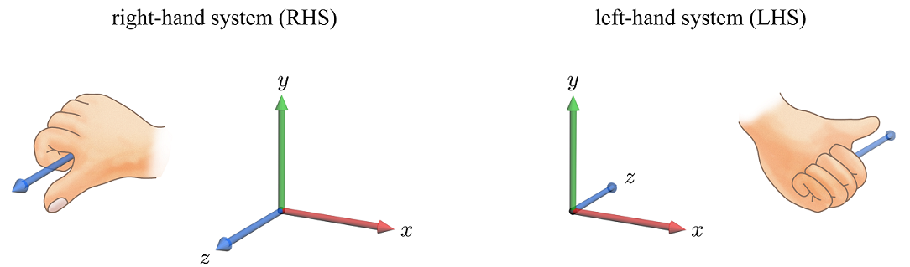
Right-hand System vs. Left-hand System
Right-hand system vs. left-hand system
5-<number>

Slide 12
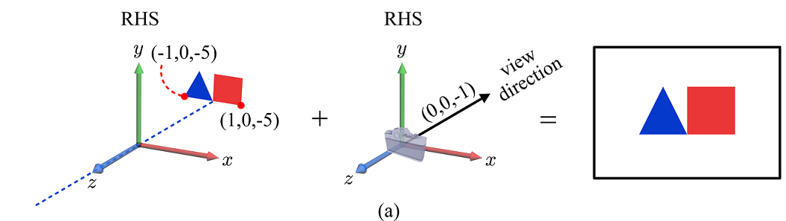
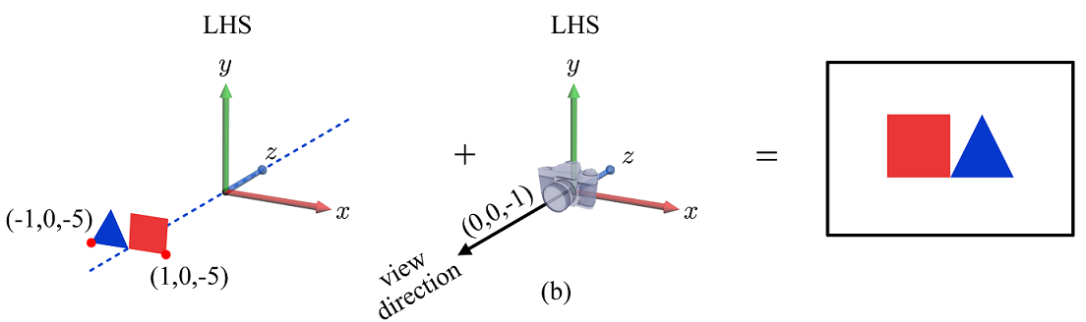
Right-hand System vs. Left-hand System (cont’d)
An inconsistency is observed if an object defined in the RHS is ported to the LHS as is together with the same camera parameters.
5-<number>

Slide 13
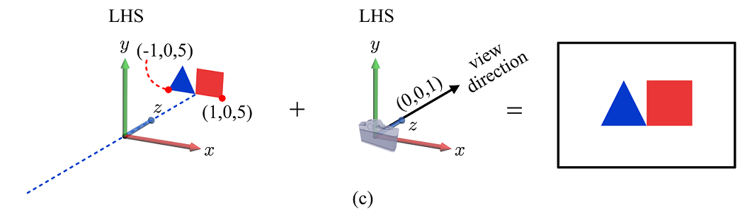
Right-hand System vs. Left-hand System (cont’d)
In order to avoid the reflected image shown in the previous page, the z-coordinates of both the objects and view parameters should be negated.
Note that z-negation is conceptually equivalent to the z-axis inversion.
5-<number>

Slide 14
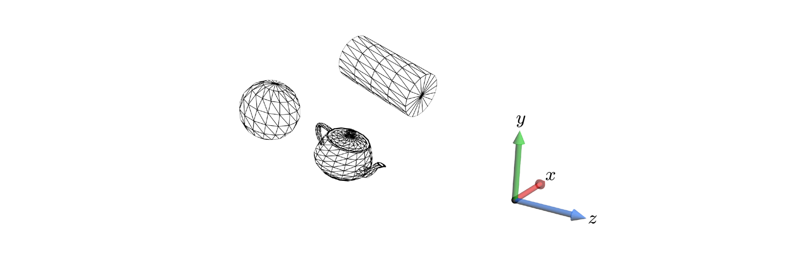
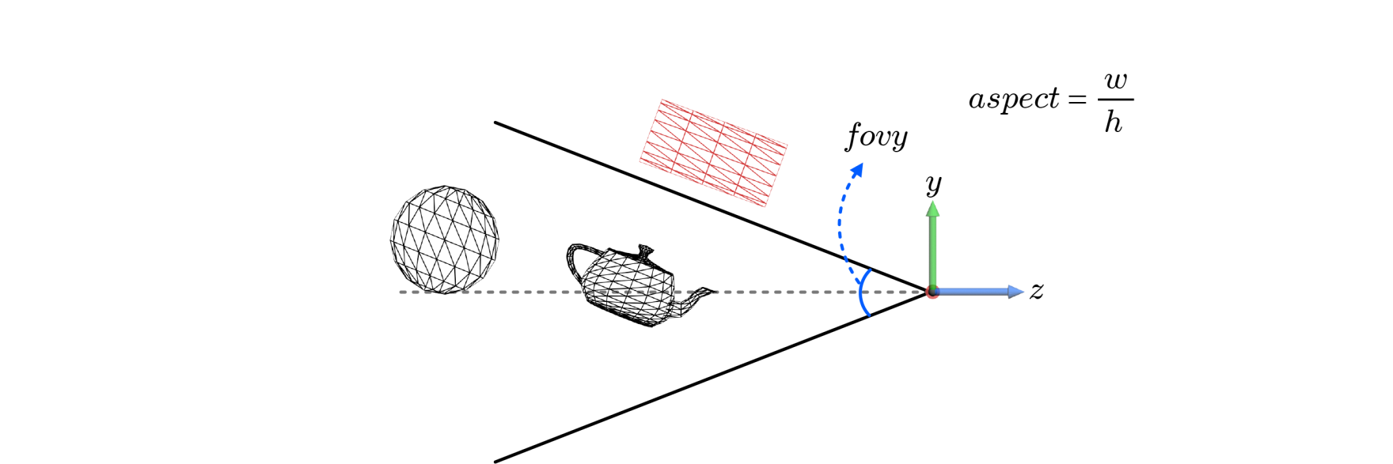
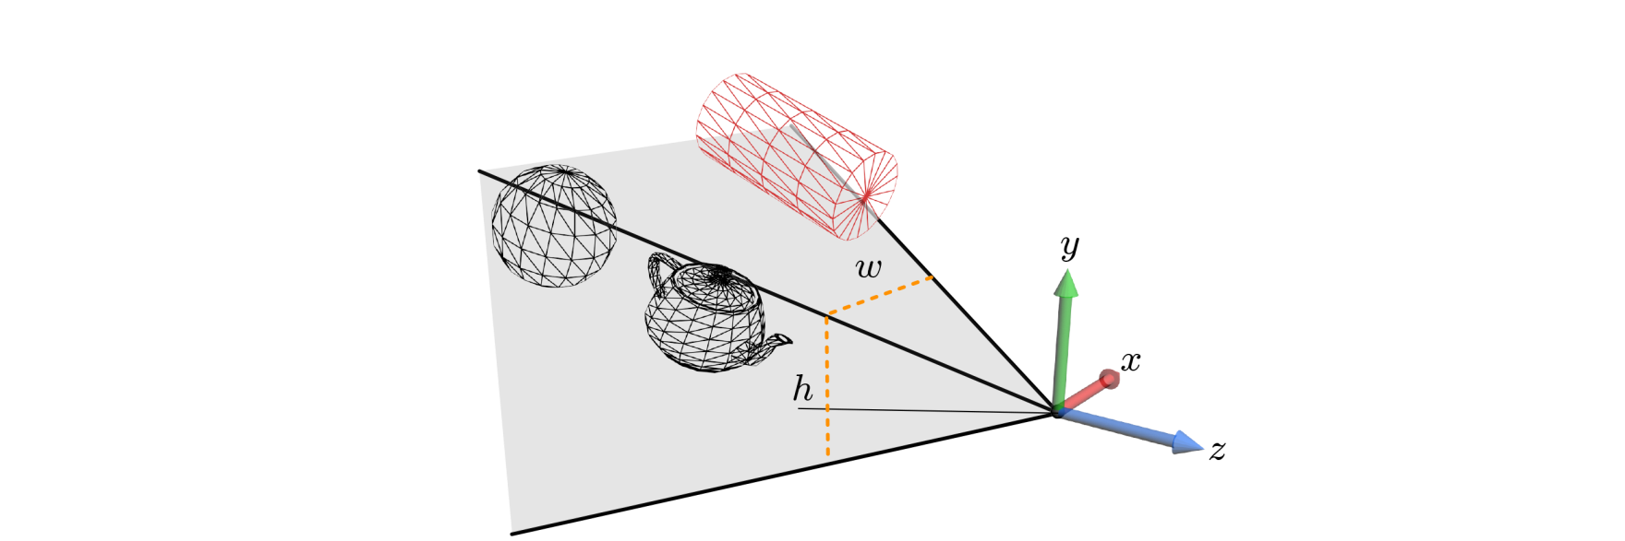
View Frustum
Let us denote the camera-space axes by {x, y, z} instead of using {u, v, n}.
EYE, AT and UP defined the external parameters of the camera. Now let’s define its internals. It is analogous to choosing a lens and controlling zoom-in/zoom-out.
An infinite pyramid is defined by fovy and aspect. Its apex is at the origin and axis is the –z axis.
5-<number>

Slide 15
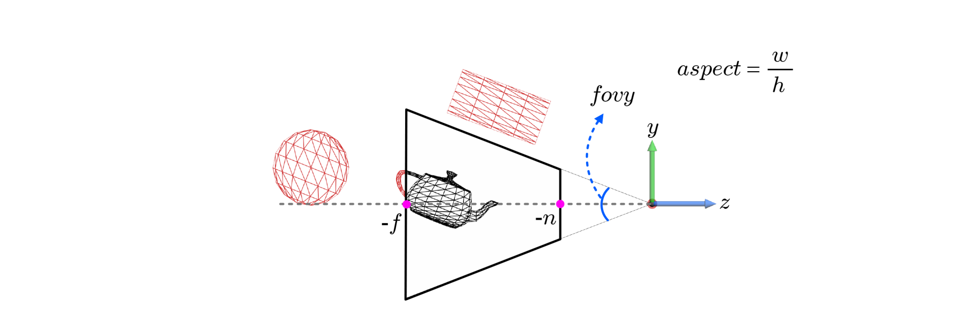
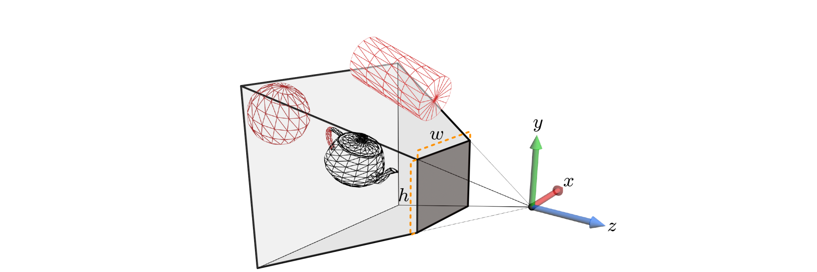
View Frustum (cont’d)
Then, n and f, which stand for the distances to the near and far planes respectively, define a truncated pyramid. It’s called view frustum.
The near and far planes run counter to the real-world camera or human vision system, but have been introduced for the sake of computational efficiency.
5-<number>

Slide 16
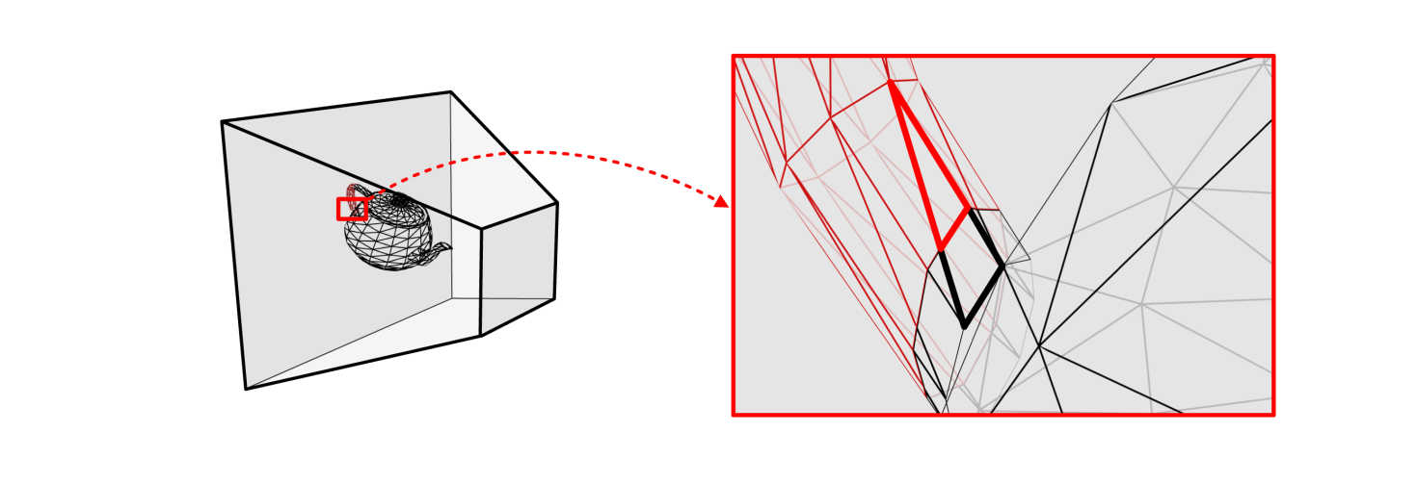
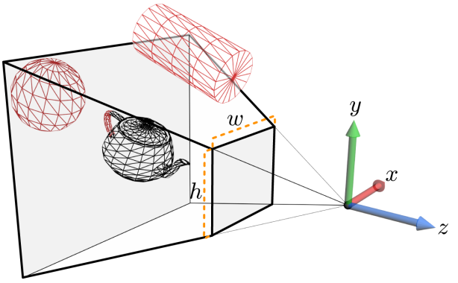
View Frustum (cont’d)
The cylinder and sphere would be discarded by the so-called view-frustum culling whereas the teapot would survive. View-frustum culling that is implemented on CPU has been studied for a long time, and there exist good algorithms.
Only the teapot will proceed to the GPU rendering pipeline.
If a polygon intersects the boundary of the view frustum, it is clipped with respect to the boundary, and only the portion inside the view frustum is processed for display.
5-<number>

Slide 17
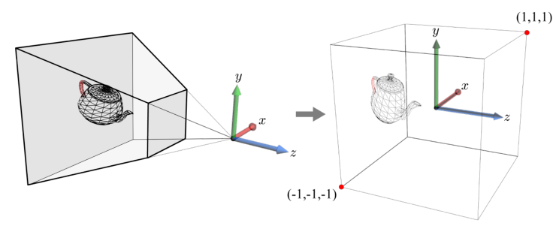
Projection Transform
The pyramidal view frustum is not used for clipping. Instead, a transform is used that deforms the view frustum into the axis-aligned 2×2×2-sized cube centered at the origin. It is called projection transform. The camera-space objects are projection-transformed and then clipped against the cube.
The projection-transformed objects are said to be in the clip space.
5-<number>

Slide 18
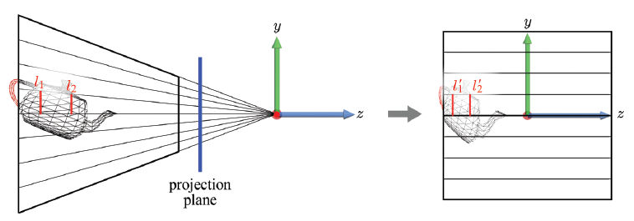
Projection Transform (cont’d)
The view frustum can be taken as a convergent pencil of projection lines. The lines converge on the origin, where the camera (EYE) is located.
All 3D points on a projection line are mapped onto a single 2D point in the projected image. It brings the effect of perspective projection, where objects farther away look smaller.
The projection transform ensures that the projection lines become parallel to the z-axis. Now viewing is done along the universal projection line. The projection transform brings the effect of perspective projection “within a 3D space.”
5-<number>

Slide 19
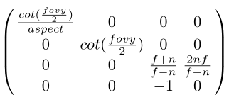
Projection Transform (cont’d)
Projection transform matrix
Derivation of the matrix is presented in the textbook.
5-<number>

Slide 20
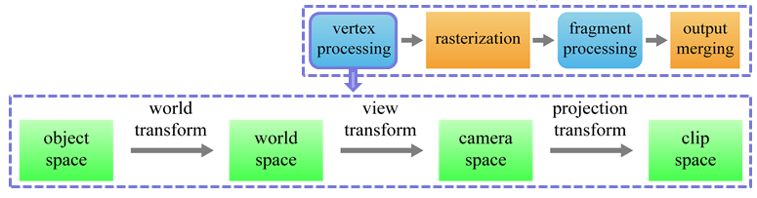


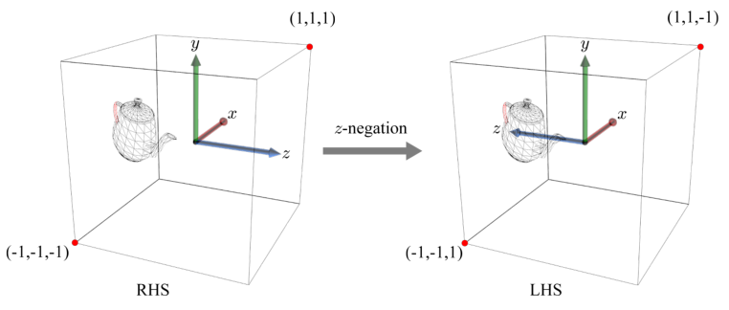
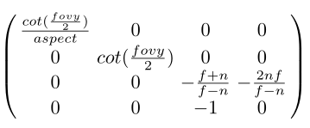
Projection Transform (cont’d)
Projection transform matrix
The projection-transformed objects will enter the rasterizer.
Unlike the vertex shader, the rasterizer is implemented in hardware, and it assumes that the clip space is left-handed. In order for the vertex shader to be compatible with the hard-wired rasterizer, the objects should be z-negated.
5-<number>

Slide 21
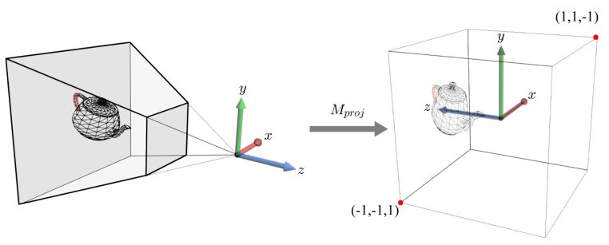
Projection Transform (cont’d)
Projection transform from the camera space (RHS) to the clip space (LHS)
5-<number>

